Slide 1
Fast Interactive Superpixel Based Image Region Generation
Dinesh Naik, Muhammed Shameem P.K, June 2019

Slide 2
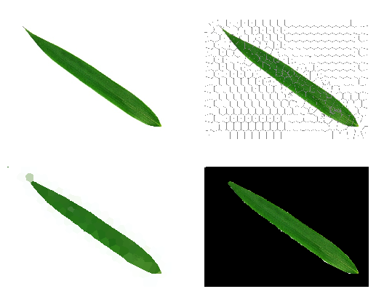
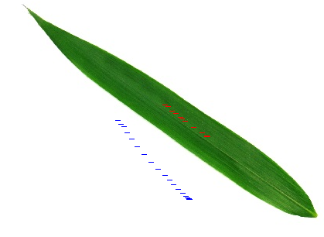

Slide 3
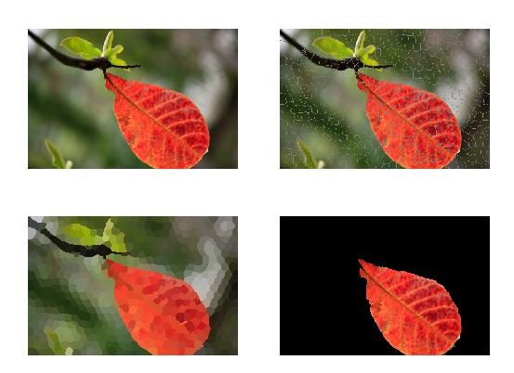
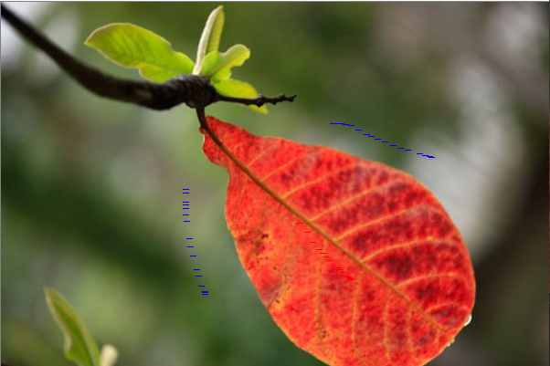

Slide 4
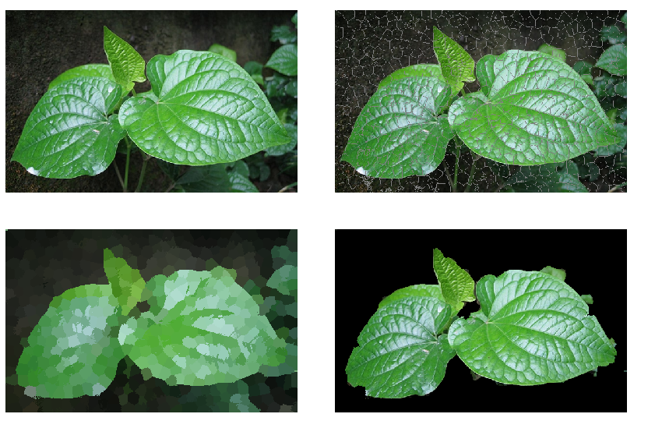
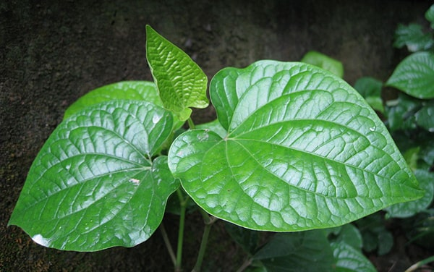

Slide 5
Image (RGB)
Image (CIELab)
Superpixel generation (SLIC)
Mapping into Graph
Boykov-Kolmogorov Min-Cut/Max-Flow

Slide 6
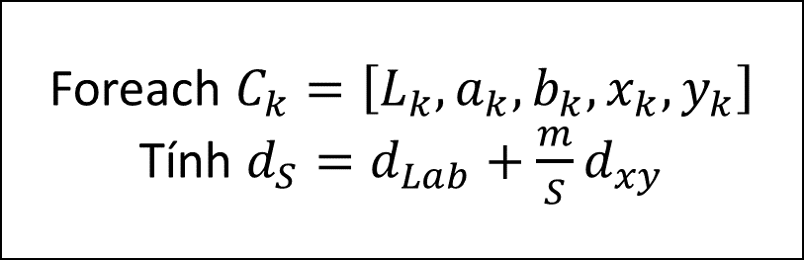
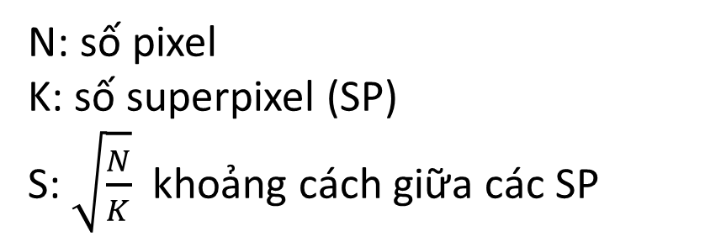
SLIC (simple linear Iterative cluster)
Init
N: số pixel
K: số superpixel (SP)
S: $\sqrt{\frac{N}{K}}$ khoảng cách giữa các SP
Foreach $C_{k}=\left[L_{k},a_{k},b_{k},x_{k},y_{k}\right]$
Tính $d_{S}=d_{Lab}+\frac{m}{S}d_{xy}$
$$d_{Lab}=\sqrt{{\left(L_{k}−L_{i}\right)}^{2}+{\left(a_{k}−a_{i}\right)}^{2}+{\left(b_{k}−b_{i}\right)}^{2}}$$
$$d_{xy}=\sqrt{{\left(x_{k}−x_{i}\right)}^{2}+{\left(y_{k}−y\right)}^{2}}$$
m là tham số tỉ trọng

Slide 7
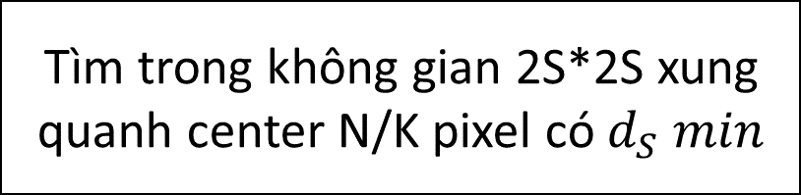
SLIC (simple linear Iterative cluster)
Tìm trong không gian 2S*2S xung quanh center N/K pixel có $d_{S} min$
No
Tính new center
d(center, new center) < threshold ?
Yes

Slide 8
Node (labeled):
sink node
source node
Node (no label):
(ob) node s
(bk) node t

Slide 9
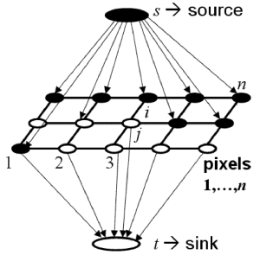
Mapping into Graph
W giữa s và n
W giữa s và n
W giữa t và n

Slide 10
Mapping into Graph
Node $u$ $(center, hist)$và $v (center, hist)$
$$sim\left(u,v\right)=e^{(−\frac{cv2. compareHist{\left(u.hist, v.hist\right)}^{2}}{2∗σ^{2}})}∗\frac{1}{distance\left(u.center, v.center\right)}$$
$$w\left(u,v\right)=1+sim(u,v)$$
c$v2.compareHist(H1,H2)⋮≡d(H1,H2)=\sum_{I}{\min\left(H_{1}\left(I\right),H_{2}\left(I\right)\right)}$

Slide 11
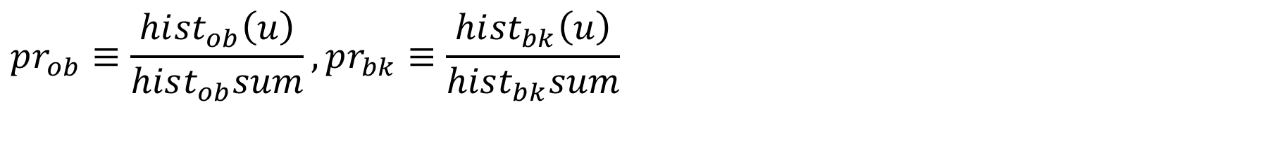
Mapping into Graph
Node s, $t$ $(center, hist)$và $u \left(center, hist\right) (no label)$
$$pr_{ob}≡\frac{hi{st}_{ob}\left(u\right)}{hist_{ob}sum},pr_{bk}≡\frac{hi{st}_{bk}\left(u\right)}{hist_{bk}sum}$$
Nếu $pr_{bk}>0 →w\left(t,u\right)=100000, w\left(s,u\right)=0.9∗−\log\left(pr_{ob}\right)$
Nếu $pr_{ob}>0 →w\left(s,u\right)=100000, w\left(t,u\right)=0.9∗−\log\left(pr_{ob}\right)$
Notes:
Xác suất là ob > 0 thì w (s – ob, u) lớn
Nhân 0.9 để w luôn < 1

Slide 12
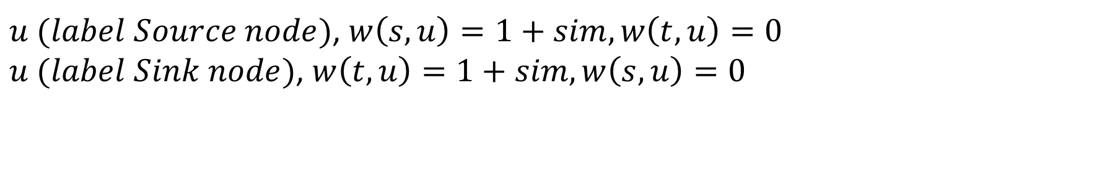
Mapping into Graph
Node $s, t (center, hist)$và $u \left(center, hist\right)$
$u (label Source node)$, $w\left(s,u\right)=1+sim, w\left(t,u\right)=0$
$u (label Sink node)$, $w\left(t,u\right)=1+sim, w\left(s,u\right)=0$
Notes:
Xác suất là ob > 0 thì w (s – ob, u) lớn
Nhân 0.9 để w luôn < 1

Slide 13
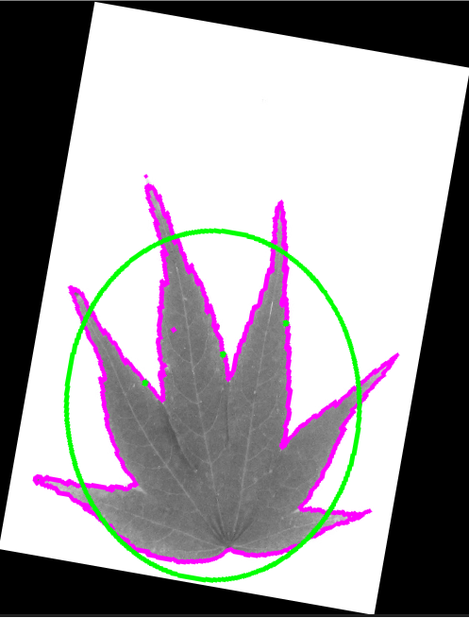


Slide 14
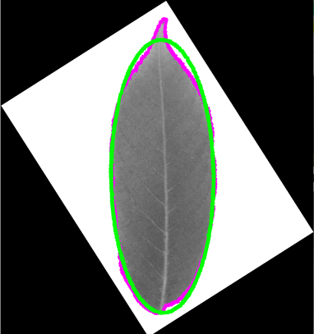


Slide 15
Find Symmetry & rotate
Image (RGB)
Gray scale
FindContours
Find angle rotate
FitEllipse
ConvexHull

Slide 16
Automated Leaf Alignment

